Slide 1


Flow Table Management
H. Jonathan Chao
ECE Department
chao@nyu.edu

Slide 2
Outline
SDN with Flow Table
Flow Table Lookup with TCAM
Geometric Representation of a Rule
Flow Table Lookup with HiCut
Network Management using Rules
Flow Table Management with DIFANE
Flow Table Management with CAB

Slide 3
Generalized forwarding: match plus action
Review: each router contains a forwarding table
“match plus action” abstraction: match bits in arriving packet, take action
(aka: flow table)
destination-based forwarding: forward based on dest. IP address
values in arriving
packet header
generalized forwarding:
many header fields can determine action
many action possible: drop/copy/modify/log packet
0111
1
3
2
forwarding table
(aka: flow table)

Slide 4
Flow table abstraction
flow: defined by header field values (in link-, network-, transport-layer fields)
generalized forwarding: simple packet-handling rules
match: pattern values in packet header fields
actions: for matched packet: drop, forward, modify, matched packet or send matched packet to controller
priority: disambiguate overlapping patterns
counters: #bytes and #packets
Flow table
Router’s flow table define router’s match + action rules
match
action

Slide 5
Flow table abstraction
flow: defined by header fields
generalized forwarding: simple packet-handling rules
match: pattern values in packet header fields
actions: for matched packet: drop, forward, modify, matched packet or send matched packet to controller
priority: disambiguate overlapping patterns
counters: #bytes and #packets
Flow table
src = *.*.*.*, dest=3.4.*.* forward(2)
match
action
src=1.2.*.*, dest=*.*.*.* drop
src=10.1.2.3, dest=*.*.*.* send to controller
* : wildcard
1
4
3
2

Slide 6
OpenFlow Controller
OpenFlow Protocol (SSL/TCP)
Switch/Router
Control Path
OpenFlow
Data Path (Flow Table Lookup and Switching)
OpenFlow/SDN tutorial, Srini Seetharaman, Deutsche Telekom, Silicon Valley Innovation Center
Notes:
Leverages hardware inside most switches today (ACL tables)

Slide 7


Controller
Switch/Router
OpenFlow Client
PC
Software
Layer
TCAM
OpenFlow Table
MAC
src
MAC
dst
IP
Src
IP
Dst
TCP
sport
TCP
dport
Action
Hardware approach:
TCAM (Ternary Content
Addressable Memory)
Algorithmic approach: HiCut or others
Hardware
Layer
*
*
*
5.6.7.8
*
*
port 1
Switch
port 1
port 2
port 3
port 4
5.6.7.8
1.2.3.4
The Stanford Clean Slate Program, http://cleanslate.stanford.edu

Slide 8
OpenFlow Flow Table Entry
Match
Action
Counter
Priority
Time-out
When to delete the entry
What order to process the rule
# of Packet/Bytes processed by the rule
Forward packet to zero or more ports
Encapsulate and forward to controller
Send to normal processing pipeline
Modify Fields
Switch
Port
VLAN
ID
VLAN
pcp
MAC
src
MAC
dst
Eth
type
IP
Src
IP
Dst
IP
ToS
IP
Prot
L4
sport
L4
dport
Theophilus Benson, CPS 590: Software Defined Networking, https://www.cs.duke.edu/courses/fall14/compsci590.4/notes/F14_Class1.pptx

Slide 9
Prioritized Rules in a Flow Table
Rule | IPd | IPs | Prot. | Port# | Appl | Action
R1 | 128.238/16 | * | TCP | telnet | * | Deny
R2 | 176.110/16 | 196.27.43/24 | UDP | * | RTP | Send to port III
R3 | 196.27.43/24 | 134.65/16 | TCP | * | * | Drop if rate > 10 Mb/s
RTP: Real-time Transport Protocol
R1: Packet Filtering
R2: Policy Routing
R3: Traffic Policing
Net C
Net A
134.65/16
128.238/16
R1
IP network
I
Telnet
Router
II
R2
RTP
Net B
III
196.27.43/24
Net D
176.110/16
MPLS network
MPLS: Multiple Protocol Label Switching
Notes:
Here is an example of a packet classifier in this router.
Rule 1 blocks all telnet connections from outside into Net A.
Rule 2 enables the router to forward all real-time traffic using real-time transport protocol (RTP) in the application layer from Net B to Net D through the ATM network, since ATM network can provide better performance guaranteed service compared to IP network.
Rule 3 limits the total transmission control protocol (TCP) traffic rate from Net C to NET B up to 10 Mbps.

Slide 10
Content Addressable Memory (CAM)
CAM is a specialized matching memory that performs parallel comparison of an input with all patterns in the entries of the CAM.
The CAM outputs the location (or address) where a match is found.
The match can be done in a clock cycle, very fast, with the expense of high power consumption and high silicon footprint.
CAM cannot be applied to CIDR (classless inter-domain routing) IP route lookup because of lacking don’t care bit.

Slide 11
Ternary CAM (TCAM)
Each bit takes three logic states
‘0’, ‘1’, and ‘?’(don’t care)
Fully associative memory: compares input string with all the entries in parallel
If multiple matches, report index of the first match
Common usage of TCAM: hardware based IP address lookup, packet classification - comparing specific header fields (e.g., 5 tuples: IP addresses, port numbers, ….) of a packet against entries (or called rules) in a flow table

Slide 12
Hierarchical addressing: route aggregation
hierarchical addressing allows efficient advertisement of routing information:
Organization 0
200.23.16.0/23
Organization 1
“Send me anything
with addresses
beginning
200.23.16.0/20”
200.23.18.0/23
Organization 2
.
200.23.20.0/23
.
Fly-By-Night-ISP
.
.
Internet
.
Organization 7
.
200.23.30.0/23
ISPs-R-Us
“Send me anything
with addresses
beginning
199.31.0.0/16”

Slide 13
Hierarchical addressing: more specific routes
Organization 1 moves from Fly-By-Night-ISP to ISPs-R-Us
ISPs-R-Us now advertises a more specific route to Organization 1
Organization 0
200.23.16.0/23
Organization 1
“Send me anything
with addresses
beginning
200.23.16.0/20”
200.23.18.0/23
Organization 2
.
200.23.20.0/23
.
Fly-By-Night-ISP
.
.
Internet
.
Organization 7
.
200.23.30.0/23
ISPs-R-Us
“Send me anything
with addresses
beginning
199.31.0.0/16”
Organization 1
200.23.18.0/23
“or 200.23.18.0/23”

Slide 14
Hierarchical addressing: more specific routes
Organization 1 moves from Fly-By-Night-ISP to ISPs-R-Us
ISPs-R-Us now advertises a more specific route to Organization 1
Organization 0
200.23.16.0/23
“Send me anything
with addresses
beginning
200.23.16.0/20”
Organization 2
.
200.23.20.0/23
.
Fly-By-Night-ISP
.
.
Internet
.
Longest Prefix Routing for IP lookup at routes
Organization 7
.
200.23.30.0/23
ISPs-R-Us
“Send me anything
with addresses
beginning
199.31.0.0/16”
Organization 1
200.23.18.0/23
“or 200.23.18.0/23”

Slide 15


ECMP Load Balancing
Pick among equal-cost paths by a hash of 5 tuples
Approximates Valiant load balancing
Preserves packet order
Problems:
Hash collisions
(coarse granularity)
Local & stateless
(v. bad with asymmetry
due to link failures)
H(f) % 3 = 0
Notes:
Valiant load balancing http://yuba.stanford.edu/vlb/

Slide 16
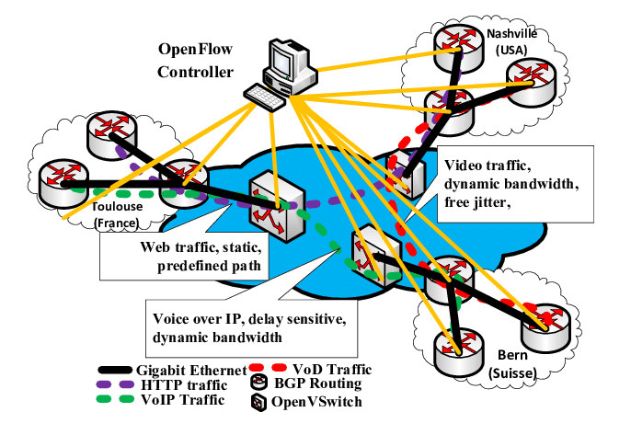
Traffic Engineering with SDN

Slide 17
Ternary CAM (TCAM)
Each entry of the TCAM stores a (val, mask) pair and matches a given input key by checking if those bits of val for which the mask bit is 1 match those in the input key
Parallel comparison to all entries
For instance, store (prefix, mask) pairs for IP address lookup, where mask indicates the prefix length, e.g., assuming 6-bit addresses, 110100/4 is denoted as a (“110100”, ”111100”) pair
IP Address
32
Network Address 1, Mask
32+32
=?
OR
Find the
First one
from Top
(A Priority
Encoder)
Network Address 2, Mask
Ordered longest prefix first
32+32
Location
=?
Network Address N, Mask
32+32
=?
Match

Slide 18
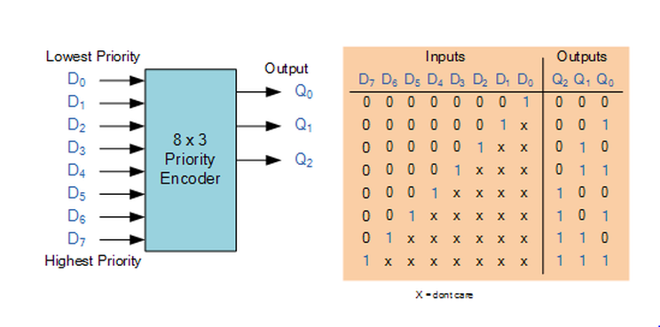
A Priority Encoder
Truth Table

Slide 19
TCAM Used for IP Longest Prefix Match
Logic structure of a TCAM device
Default route (mask = 0)
Since there may be multiple matches found at the
same time, a priority encoder is used to
select a match with the highest priority as the output.
The priority is determined by the memory location.
The lower the location, the higher the priority.
Whenever a match operation is triggered, an incoming
32-bit destination IP address is compared with
all TCAM entries bit by bit, respectively, and
simultaneously.
The forwarding table is stored in
the TCAM in an increasing order of
prefix lengths, so that the longest
prefix is selected by the priority
encoder.
Notes:
Read the following slides when show this slides.
TCAM based schemes are kinds of hardware-based IP routing lookup scheme, which based on a special memory device TCAM.
Here TCAM stands for Ternary Content-addressable memory, which is a special CAM. Anyone knows the difference between CAM and standard computer memory, such as SRAM and SDARM?
OK.
When SRAM or SDRAM is used, user need to supply the memory an address, and then the memory return the content stored at that address.
However, when CAM is used, instead of supplying an address, users need to supply the CAM the content to be searched. Then, the CAM searches its entire memory to see if the input content stored anywhere in it. If the data word is found, the CAM returns a list of one or more storage addresses where the word was found (and in some architectures, it also returns the data word, or other associated pieces of data).
unconcerned
Unlike standard computer memory (random access memory or RAM) in which the user supplies a memory address and the RAM returns the data word stored at that address, a CAM is designed such that the user supplies a data word and the CAM searches its entire memory to see if that data word is stored anywhere in it. If the data word is found, the CAM returns a list of one or more storage addresses where the word was found (and in some architectures, it also returns the data word, or other associated pieces of data).
The output from the TCAM is then used to access RAM, in which the next hop information is stored in the same location as the prefix in the TCAM.

Slide 20
Ternary CAM (TCAM)
Performance
Advantage
TCAM returns the result of the longest matching prefix lookup within only ONE memory access, independent of the width of the search key.
TCAM technology (e.g., Renesas R8A20410BG )
Fast match: 360 MSPS (million searches per second)
Size: 20M bits with 40-, 80-, 160-, 320-, 480-, or 640-bit search key-width
Disadvantage
High cost-to-density ratio
High power consumption (10 ~ 15 Watts/chip)
Update can be complex if some prefix sections are full

Slide 21
Geometric Representation of a rule
Each rule can be specified in either a prefix/length pair or an operator/number form (e.g., =, >, <, or a range).
From a geometric point of view,
A rule with two fields represents a rectangle in the 2-dimensional space
A rule with d fields represents a d-dimensional hyper-rectangle
A rule is a set of such hyper-rectangles with priorities associated.

Slide 22
Geometric Representation of a rule
Given a packet header (d-tuple), it represents a point P in the d-dimensional space. The rule matching problem is to find the highest priority hyper-rectangle that encloses P.
For example, given a rule set as below:
Geometric representation of a rule is rectangles overlapped
according to their priorities.

Slide 23
Geometric representation of a rule
1) The geometric representation of rule R1
R1
11*
00*

Slide 24
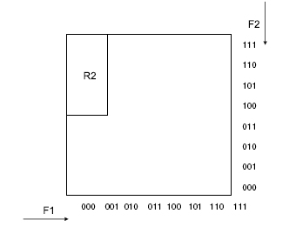
Geometric representation of a rule
2) The geometric representation of rule R2

Slide 25
Geometric representation of a rule
3) The geometric representation of rule R3

Slide 26
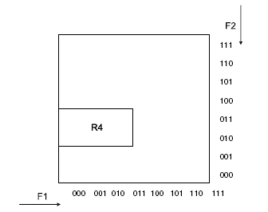
Geometric representation of a rule
4) The geometric representation of rule R4

Slide 27
Geometric representation of a rule
5) The geometric representation of rule R5

Slide 28
Geometric representation of a rule
6) The geometric representation of rule R6

Slide 29
Geometric representation of a rule
7) The geometric representation of rule R7

Slide 30
Finding a rule matched with a packet
A packet’s fields are extracted and mapped to the geometric area, which is a dot (P).
A rule that encloses the dot and has the highest priority is the rule matched (e.g., R1).
How to construct a data structure corresponding the geometric representation of all rules to facilitate the search?
Given P(001,110)
F2
Geometric
Representation
F1

Slide 31
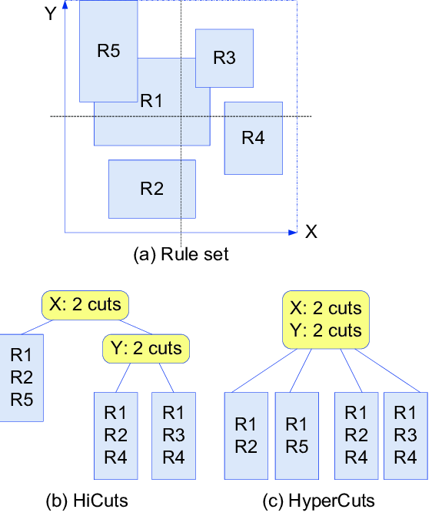
HiCut vs. HyperCuts Decision Tree
R1
Divide the entire rule set into multiple subsets, each with rules less than or equal to a threshold (e.g. 3)
Liner search within each subset to find a rule that matches the incoming packet’s fields
R5

Slide 32
Hierarchical Intelligent Cuttings (HiCuts)
When a packet arrives,
(1) The HiCut algorithm uses the value of the fields in the packet header to traverse the decision tree until a leaf node, where a small number of rules are stored.
(2) A linear search of these rules in the leaf node yields the desired matching.
Incoming Packet
1
1
2
Linear Search for the desired rule

Slide 33
HiCuts - Construction
The HiCuts algorithm builds a decision tree data structure by carefully preprocessing the classifier. Each internal node v of the decision tree built on a d-dimensional classifier is associated with:
1. A box B(v), which is a d-tuple of ranges or intervals: ([l1 : r1], [l2 : r2], . . . , [ld : rd]), meaning (left point, right point)
2^{w}-1
As an example, consider the case of two W-bit-wide dimensions. The root node, v, represents a box of size 2^{W} x 2^{W}.
0
0
2^{w}-1

Slide 34
HiCuts - Construction
2. A cut C(v), defined by
1) a dimension i,
2) and np(C), the number of times that B(v) is cut (partitioned) in dimension i (that is, the number of cuts in the interval [li : ri]). The cut thus evenly divides B(v) into smaller boxes, which are associated with the children of v.
Root node
y
Cut cross X
Cut C(v)=4
In the given example, Cut C(v) is described by the number of equal intervals we cut in a particular dimension of box B(v). If we decide to cut the root node along the first dimension into D intervals, the root node will have D children, each with an associated box of size
(2^{W}/D) x 2^{W}.
x
4 intervals and 4 children

Slide 35
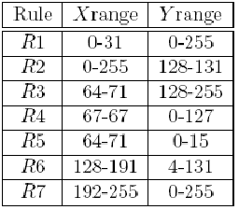
HiCuts - Construction
3. A set of rules R(v) for node v
The tree's root has all the rules associated with it.
If node u is a child of node v, then R(u) is defined as a subset of R(v).
That is, every rule in R(v) that spans, cuts, or is contained in B(u) is also a member of R(u).
Get a Leaf node
We perform cutting on each level and recursively on the children of the nodes at that level until the number of rules in the box associated with each node falls below a threshold called binth (bin size threshold).
A node with fewer than binth rules is not partitioned further and becomes a leaf of the tree.
To illustrate: Given a rule set example with two dimensions.

Slide 36
HiCuts - Construction
And the geometrical presentation of the classifier:
R1: X range{0-31}
Y range{0-255}
R2: X range{0-255}
Y range{128-131}

Slide 37
HiCuts - Construction
R3: X range{64-71}
Y range{128-255}
R4: X range{67-67}
Y range{0-127}

Slide 38
HiCuts - Construction
R5: X range{64-71}
Y range{0-15}
R6: X range{128-191}
Y range{4-131}

Slide 39
HiCuts - Construction
When two or more are overlapped, consider their priorities.
R7: X range{192-192}
Y range{0-255}
Geometrical representation of all 7 rules:

Slide 40
HiCuts - Construction
Determine R(u):
In a sub-region of node u, which is depicted within the blue rectangle, R1 is contained and R2 is spanned. So both of rules will be stored associated with node u, R(u).
The root node V
u
R1, R2

Slide 41
HiCuts - Construction
The following figure shows a possible decision tree.
Each ellipse denotes an internal node
v with a triplet (B(v); dim(C(v)); np(C(v)))
The root node u denotes the entire space with the box B(v) =256*256.
B(v) is cut into four small boxes in dimension X
each square is a leaf node containing no more than 2 rules
In this example, bin thrsthold equals 2. Therefore, the set with R2, R3, R4, and R5 is further cut in Y dimension.

Slide 42
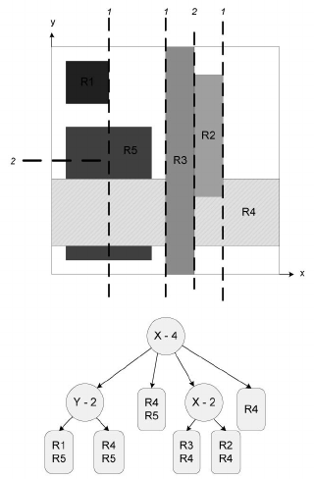
HiCut Data Structure Example
R1
R1
R5
4 even intervals in x axis
2 even intervals
in y axis

Slide 43
HiCuts Summary
Each time a packet arrives, the HiCut classification algorithm traverses the decision tree to find a leaf node, which stores a small number of rules. A linear search of these rules yields the desired matching
Performance:
The characteristics of the decision tree (its depth, degree of each node, and the local branching decision to be made at each node) can be tuned to trade off query time against storage requirements.
The more cuts in each dimension, the higher searching speed, but also more storage space
Cuts are chosen while preprocessing the classifier based on its characteristics.
Case study: 40 real-life 4D classifiers and some with up to 1700 rules
HiCuts requires less than 1 Mbyte of storage
A worst-case query time of 20 memory accesses
Supports fast updates

Slide 44
Edge Network Management
Modified from Prof. Minlan Yu’s conference slides
at CoNEXT’09 and Sigcomm’10
(Read assignment: Sections 1, 2, 3, & 5 of Sigcomm’10)

Slide 45




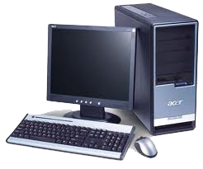
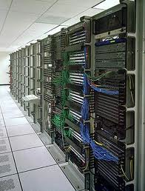





Edge Networks
Enterprise networks
(corporate and campus)
Data centers (cloud)
Internet
Home networks
Notes:
Boven:
Today’s network is a network of networks. We have the Internet to provide global access
and the edge networks sitting at the edge of the Internet to provide different services and access.
Some typical edge networks include Enterprise networks (i.e. Poly), Data Centers (i.e. Amazon’s AWS) and our home networks.
Traditional Internet research focuses on the *inside* of the Internet, or on the protocols running on the end hosts.
However, with the growth of various network applications, research Interest is shifting from the Internet to the edge networks.
Since these networks (DC) generally provides service and access, the design and management of these networks significantly affect user experience and service quality.
Today most researches focus on how to make these networks bigger, faster, and more efficient. But one under-explored area that is important for realizing all these goals is management
Minlan:
focus
I work on edge networks, edge networks are the networks that are at the edge of the Internet
There have been growing interest at the edge of the Internet such as the networks in companies, campuses, data centers, and home.
%Traditional Internet research focuses on the *inside* of the Internet, or on the protocols running on the end hosts.
There have been growing interest at these edge networks, because the design and management of these networks significantly affect the users experience and service quality.
Today most researches focus on how to make these networks bigger, faster, and more efficient. But one unexplored area that is important for realizing all these goals is management

Slide 46


Redesign Networks for Management
Management is important, yet underexplored
Taking 80% of IT budget
Responsible for 62% of outages
Making management easier
The network should be truly transparent
Redesign the networks
to make them easier and cheaper to manage
Notes:
Boven:
According to some industrial studies. 80% budget, and responsible for 62% outages.
Remember we have so many edge network, and each can have a huge army of people to manage them.
An intuitive thought is how can we make this easier?
Is there a way to make network management truly transparent to network management, so that we can manage different networks in the same way without caring about the details?
So the problem is how we can redesign the network to make them easier and cheaper to manage.
Minlan:
Managing edge networks is important…
Transparent, and second to application
Redesign
rather than "bolting on" management to the existing network, you are changing the network to make it inherently easier to manage
Much research focuses on making faster…
management is 80% of cost and responsible for more than half of outages. So, while much research focuses on making networks faster and more efficient, you're focusing on the underexplored problem of how to make them easier to manage. You could also stress that there are so many of these edge networks, each with a huge army of people to manage them, and often to keep them easy enough to manage there are restrictions on how they grow and what kinds of applications they support. (e.g., in our department, there are a lot of restrictions imposed by our clumsy firewall.) To realize the full power of the Internet in our lives, to make the network truly transparent, we *must* make networks easier and less expensive to manage. The best technologies are the ones that disappear, that become transparent as the air we breathe. Networking today is far from that goal.
networks were not designed for management, and your goal is (rather than "bolting on" management to the existing network, you are changing the network to make it inherently easier to manage

Slide 47

Main Challenges in Edge Networks
The network that hosts, switches and applications running on is constantly growing. So how to scale the network functions over the growing network becomes challenging
Flexible Policies (routing, security, measurement)
Large Networks
(hosts, switches, apps)
Enable specific routings for certain applications.
Enhance security for certain hosts or apps.
Measure network statistics for better resource optimization.
Using commodity switches can be unreliable.
How to manage the network with these switches to have a robust network becomes challenging.
Commodity switches
(cost, energy, reliability)
Notes:
Boven:
Our mgmt of edge networks is facing 3 maj challenges,
Growing larger. Hosts, switches, app.
Flexible policies. Enable specific routings for certain applications. Enhance security of certain hosts or apps. And measuring the network stats for better resource opt.
To reduce cost and energy, today’s network vendors tends to use simple switches However, using these simple switch can be unreliable. So how to manage the network with these simple and commodity switches become hard
Minlan
There are three main challenges on managing the edge networks:
First, these networks are growing bigger with more and more. The network hosts, switches and applications running on it is constantly growing. So how do we scale the network functions over the growing network is becoming challenging
Second, to enhance the management of the network. We want to enable flexible network policy
Each of these challenges is already a hard problem itself, addressing all the three challenges together is a even harder problem. In this talk I’ll show you how we achieve the three goals together.
//presumably you'll say something about the parenthetical comments for each of the three topics. And prepare the audience that you'll briefly discuss each of these three topics to set the stage for your research.

Slide 48




Large Enterprise Networks
Hosts
(10K - 100K)
Switches
(1K - 5K)
….
Applications
(100 - 1K)
….
Notes:
Boven:
Let’s first get a brief idea about the network scales.
So one example of the edge network can be our Poly’s campus network, which is an enterprise network.
Lying at the edge are hosts (e.g.) 10K-100K
To enable connectivity, these hosts are conn with switches (1K-5K)
And running .. App (e.g.)
So the mgmt issues in this network include (e.g.)
How do we ensure (printer, db) available at all times
To improve user exp. Such as fluent VoIP calls
Considering so many hosts…

Slide 49






Large Data Center Networks
Switches
(1K - 10K)
….
….
….
….
Servers and Virtual Machines
(100K – 1M)
Applications
(100 - 1K)
Handle VM migration
Load balancing (e.g. CONGA)
Anomaly detection/isolation
Task scheduling for MapReduce
Notes:
Boven:
Another example of edge network is the DCN.
In a typical DCN,
…
A typical mgmt problem is VM migration, which …
Here we focus on netw mgmt, how to operate the netw s.t. the communication is non-breaking… and not affect other..
Considering so many…

Slide 50




Flexible Policies Deployed as Rules
Considerations:
- Performance
- Security
- Mobility
- Energy-saving
- Cost reduction
- Debugging
- Maintenance
… …
Customized Routing
… …
Measurement
Diagnosis
Access Control
Alice
Alice
Notes:
Boven:
Generally to manage a network, soooo many considerations…
To resolve the problems…
We may want to customize the routing…
e.g. for some final app (stock info exchange), reducing the delay imp, op shall consider customize a low-latency path
Network security is also …
E.g. in some military networks, many info are confidential. How to block some malicious users (e.g. terrorists to get access) while normal service can function as usual…
And we may want to have measurement/diagnosis …
E.g. in a public cloud such as AWS, measurement of Bw for users directs charging. And sometimes mal-function services needs to be found out by network diagnosis.
Minlan:
Soooooo many considerations
For trading applications that exchange real-time stock information in the cloud, reducing the delay of milliseconds is very important, operators will configure low-latency path to these apps.
Network security is also an important goal. In a medical company network, the operators need to make sure malicious users cannot access the patients’ private data, so they have to install access control rules..
In a cloud, cloud providers may bill the users based on the number of bits they use. So operators need to make sure they accurately count the amount of traffic from different users.
In these large edge networks, operators want to apply flexible policies to make the network more secure, support host mobility… For example, many applications have strict requirements on network performance, operators need to configure different routing paths for different applications. For the applications that transfer real-time market information in data center, operators may want to configure them to use low-latency path. These enterprise and especially data centers are the target of different attacks. To improve security, operators may need to install access control rules to block the traffic from malicious users. Finally measurement and diagnosis is also important to identify the potential problems and ensure the network is robust for the users. For example, operators may want to investigate the amount of web traffic in the network, who is using the most bandwidth.

Slide 51
Switch Constraints
Increasing link speed
(10Gbps and more)
Switch
Small, on-chip memory
(expensive,
power-hungry)
Scaling network
Flexible policies
Storing lots of state
Forwarding rules for many hosts/switches
Access control and QoS for many apps/users
Monitoring counters for specific flows
Notes:
Boven:
Finally let’s take a look at today’s switch constraints.
Due to network traffic… each link 10Gbps… for a switch with 48ports … 1byte per nano... So such high speed processing => requires on chip memory
These memory small, power hungry.
Remember that bunch of policies and scale of networks, this can map to a lot of states on a switch, (e.g.)
Minlan:
1byte per nanosecond
High speed, we cannot just use normal memory, we have to use high speed, onchip memory → expensive, power hungry → small → but lots of state
All these require such a large amount of state that a switch cannot handle

Slide 52
Edge Network Management
Specify policies
Management System
Configure devices
Collect measurements
DIFANE [SIGCOMM’10]
Scaling flexible policy deployment
CAB [HotSDN’14]
Enabling efficient rule caching
Notes:
Operators first specify…
My research focuses on how to redesign the network to address the three challenges at the same time. I built two systems:
Due to the three challenges, today, network operators devote tremendous time and effort to network management.
Yankee group reports that in enterprises 80% of IT budget is spent on network management.
But they can only support a limited management tasks.
I built two new systems that make the network more scalable and easier to manage.
Focus on DIFANE, and give a brief description of SNAP
How to design network functions that best support different management tasks
How to implement different management tasks in the network

Slide 53

Scalable flow-based networking with DIFANE [Sigcomm’10] Minlan Yu, Jennifer Rexford, Michael J. Freedman, Jia Wang
Do It
Fast ANd
Easy
Notes:
Joint work with …

Slide 54

Traditional Network
Management plane:
offline, sometimes manual
Control plane:
Hard to manage
Data plane:
Limited policies
New trends: Flow-based switches & logically centralized control to achieve fine-grained control through a single point centrally
Notes:
Boven
Traditional：dp and cp are on switches.
DP forward the packet, CP are brain which in charge of forwarding and routing though protocols running across switches.
Since software code is bundled in the switch box, Diff vendors support diff policy in DP, limited.
Mgmt configure each switch manually.
Minlan
Traditional networks: the data and control plane are both on the switches.
The data plane is the hardware part of the switch, which actually forward the packets, and the control plane are the so-called brain of the switch, the protocols that make all of the decisions about where traffic should go. Different vendors may provide different sets of policy support in the data plane, and it is limited. The software code in the control plane is also bundled with the switch, so it is hard for operators to manage. So most of the management tasks in these networks are done in an offline fashion and sometimes just manually configuring each switches.
Brains are on the switches themselves→ scalable, data plane
Control plane: not standard, private code

Slide 55

Data plane: Flow-based Switches
Perform simple actions based on rules
Rules: Match on attributes in the packet header
Actions: Drop, forward, count
Store rules in high speed memory (TCAM)
Flow space
TCAM (Ternary Content
Addressable Memory)
src. (X)
forward via link 1
dst.
(Y)
1. X:* Y:1 → drop
2. X:5 Y:3 → drop
3. X:1 Y:* → count
4. X:* Y:* → forward
Count packets
drop
Notes:
Boven:
In this context we consider the flow based switches.
Each switch matches on packet headers on different attributes. E.g.
Performs actions (drop, forward, count).
Supported in TCAM
Minlan
commercial switches supporting OpenFlow are available (e.g., from HP, NEC, and Quanta) and that several operational networks are already deploying OpenFlow.
TCAM: 64Mbit (8MB) 3-4ns lookup time, 100$, 20W, 1M (32 bit prefix 32bit associated value) (1U == 200-400 Watt)
SRAM: 512KB 1$/MB 1-3 W
Priority
> - define TCAM, so audience understands what they are and why they are so
> useful for matching on packets. stress more that, because they match the
> packet against all rules in parallel, TCAMs are expensive and power-hungry,
> so you are often limited in the # of rules the switch can support. some of
> the details of TCAMs -- how they work, how expensive they are -- matter
> later in the talk, so good to explain a bit more when you first introduce them

Slide 56


Control Plane: Logically Centralized
In the controller: high level policies
In the switch: fine grain rules
DIFANE:
A scalable way to apply fine-grained policies
Notes:
Boven:
Many research work applies SDN to manage these Flow based switches.
The idea is to have a logically centralized control plane.
In the controller … high level policies
In the switch … fine grain rules
(the limited TCAM space and the limited resources on the controller). the two strawman solutions -- pre-installed rules and Ethane -- each address one scaling problem at the expense of the other.

Slide 57

Pre-install Rules in Switches
Pre-install
rules
Controller
Packets hit
the rules
Forward
Problems:
TCAM space is limited (1000~4000 OpenFlow rules)
No host mobility support
Notes:
Boven:
TCAM: 64Mbit (8MB) 3-4ns lookup time, 100$, 20W, 1M (32 bit prefix 32bit associated value) (1U == 200-400 Watt)
Minlan:
Specify high-level policies in a management system
Enforce low-level rules in the switches
Host mobility is not stressed before…

Slide 58
Cache Rules on Demand (Ethane)
Buffer and send
packet header
to the controller
Controller
cache
rules
First packet
misses the rules
Forward
Problems:
Computation load at the controller is high
Delay of going through the controller (~10ms)
Switches mis-behave when requesting rules
Notes:
10 ms→ leaving the fast data plane
Ethane does reactive solution not NOX
Sending the whole packet consume too much traffic in the controller
Mention switch bottleneck
----- Meeting Notes (10/10/14 16:03) -----
Pre-install // Ethane...

Slide 59
Design Goals of DIFANE
Scale with network growth
Limited TCAM at switches
Limited resources at the controller
Improve per-packet performance
Always keep packets in the data plane
Minimal modifications in switches
No changes to data plane hardware
Combine pre-installation and caching approaches for better scalability
Notes:
New algorithm and data structure that have these properties

Slide 60


DIFANE: Combining Proactive & Reactive
Install rules
Features | Pre-install | Cache (Ethane) | DIFANE
Host mobility
Memory usage
Keep packet in data plane

Slide 61
DIFANE Architecture (two stages)
DIstributed Flow Architecture
for Networked Enterprises
Doing it Fast and Easy

Slide 62
Stage 1
The controller proactively generates the rules and distributes them to authority switches.

Slide 63

Partition and Distribute the Flow Rules
Flow space
accept
Controller
Distribute partition information
AuthoritySwitch B
Authority Switch A
Authority Switch C
reject
Authority
Switch B
Egress Switch
Authority
Switch A
Ingress Switch
Authority
Switch C

Slide 64
Stage 2
Ingress switches reactively cache rules from authority switches.

Slide 65
Packet Redirection and Rule Caching
Authority Switch
Feedback:
Cache rules
Ingress Switch
Forward
Egress Switch
Redirect
First packet
Following packets
Hit cached rules and forward
A slightly longer path in the data plane is faster than going through the control plane

Slide 66
Locate Authority Switches
Partition information in ingress switches
Using a small set of coarse-grained wildcard rules
… to locate the authority switch for each packet
A distributed directory service of rules
Hashing does not work for wildcards
Keys can have wildcards in arbitrary bit positions
Fixed-length keys could use hash. Haw?
AuthoritySwitch B
X:0-1 Y:0-3 ➔ A
X:2-5 Y: 0-1➔B
X:2-5 Y:2-3 ➔ C
Authority Switch A
Authority Switch C

Slide 67
Packet Redirection and Rule Caching
 | R₂
R₁
 | R₂
R₁
z
Authority Switch A
Feedback:
Cache rules
Ingress Switch
Auth. Rules
Forward
Egress Switch
First
packet
Redirect
Cache Rules
Partition Rules
Following packets
Hit cached rules and forward
Auth. Rules
R₁
z
z
Authority
Switch B
R₁
Go to switch A
Go to switch B

Slide 68
Three Sets of Rules in TCAM
Type | Priority | Field 1 | Field 2 | Action | Timeout
Cache Rules | 210 | 00** | 111* | Forward to Switch B | 10 sec
 | 209 | 1110 | 11** | Drop | 10 sec
 | … | … | … | … | …
Authority Rules | 110 | 00** | 001* | Forward Trigger cache manager | Infinity
 | 109 | 0001 | 0*** | Drop, Trigger cache manager
 | … | … | … | … | …
Partition Rules | 15 | 0*** | 000* | Redirect to auth. switch
 | 14 |  |  | …
 | … | … | … | … | …
In ingress switches
reactively installed by authority switches
In authority switches
proactively installed by controller
In every switch
proactively installed by controller

Slide 69
DIFANE Switch Prototype _{Built with OpenFlow switch}
Cache rules
Recv Cache
Updates
Send Cache
Updates
Only in Auth. Switches
Control Plane
Cache
Manager
Notification
Just software modification for authority switches
Cache Rules
Data
Plane
Authority Rules
Partition Rules

Slide 70
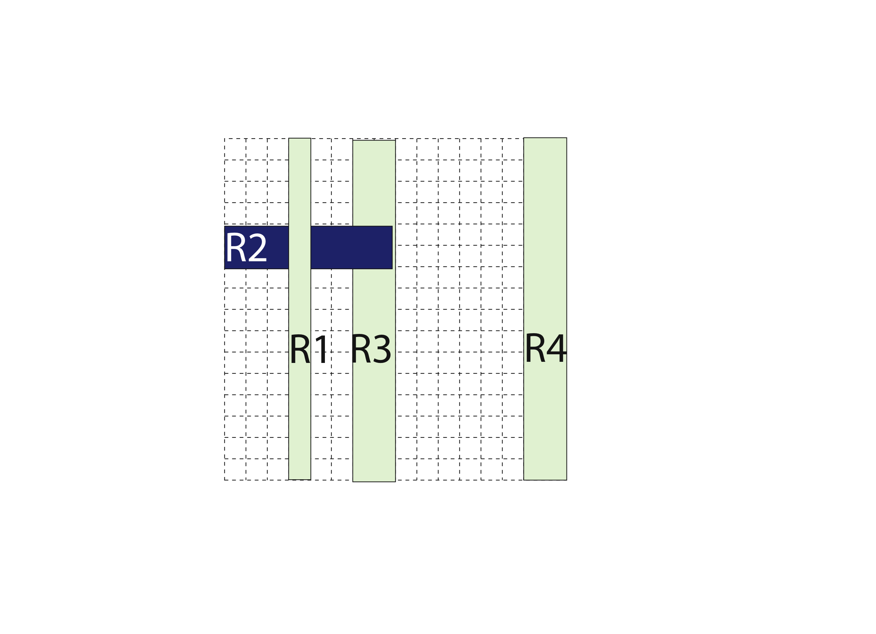
Caching Wildcard Rules
Overlapping wildcard rules
Cannot simply cache matching rules
src.
dst.
Priority:
R1>R2>R3>R4

Slide 71
Caching Wildcard Rules
Multiple authority switches
Contain independent sets of rules
Avoid cache conflicts in ingress switch
Authority switch 1
Authority switch 2

Slide 72
Partition Wildcard Rules
Partition rules
Minimize the TCAM entries in switches
Decision-tree based rule partition algorithm
Cut B is better than Cut A
Cut B
Cut A
Notes:
NP-hard problem for K >= 2

Slide 73
Handling Network Dynamics
Network dynamics | Cache rules | Authority Rules | Partition Rules
Policy changes at controller | Timeout | Change | Mostly no change
Topology changes at switches | No change | No change | Change
Host mobility | Timeout | No change | No change

Slide 74
Prototype Evaluation
Evaluation setup
Kernel-level Click-based OpenFlow switch
Traffic generators, switches, controller run on separate 3.0GHz 64-bit Intel Xeon machines
Compare delay and throughput
NOX: Buffer packets and reactively install rules
DIFANE: Forward packets to authority switches

Slide 75
Testbed for Throughput Comparison
Testbed with around 40 computers
Ethane
DIFANE
Controller
Controller
Authority Switch
….
….
Traffic generator
Traffic generator
Ingress switch
Ingress switch
Notes:
Prototype with OpenFlow switches, evaluate on a test bed of over 40 machines
One authority switch, first-packet flows.

Slide 76
Delay Evaluation
Average delay (RTT) of the first packet
NOX: 10 ms
DIFANE: 0.4 ms
Reasons for performance improvement
Always keep packets in the data plane
Packets are delivered without waiting for rule caching
Easily implemented in hardware to further improve performance

Slide 77
Peak Throughput
One authority switch; First Packet of each flow
1 ingress switch
2
3
4
DIFANE
Ethane
DIFANE
(800K)
DIFANE is self-scaling:
Higher throughput with more authority switches.
Ingress switch
Bottleneck
(20K)
Controller
Bottleneck (50K)
Notes:
Boven:
Increasing sending rate, Ethane touches throughput bottleneck of ingress switch at beginning. (Thoughput of ingress switch is bounded)
Increasing the No. of ingress switch, then Ethane touches controller bottleneck. (Total throughput is limited.)
Stress log scale
DIFANE is self-scaling
35pkts per flow on average

Slide 78
Scaling with Many Rules
How many authority switches do we need?
Depends on total number of rules
… and the TCAM space in these authority switches
 | Campus | IPTV
# Rules | 30K | 5M
# Switches | 1.7K | 3K
Assumed Authority Switch TCAM size | 160 KB | 1.6 MB
Required # Authority Switches | 5 (0.3%) | 100 (3%)
Notes:
.

Slide 79
Summary: DIFANE in the Sweet Spot
Distributed
Logically-centralized
Traditional network
(Hard to manage)
OpenFlow/Ethane
(Not scalable)
DIFANE: Scalable management
Controller is still in charge
Switches host a distributed directory of the rules
Notes:
A new data structure that harnesses the capacity of the TCAMs across all the switches to give the illusion of a much larger TCAM.

Slide 80
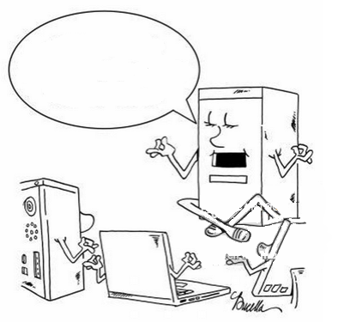
CAB: A Reactive Wildcard Rule Caching System for Software-Defined Networks [HotSDN’ 14] Bo Yan, Yang Xu, Hongya Xing, Kang Xi, H. Jonathan Chao
CAching rules in Buckets

Slide 81
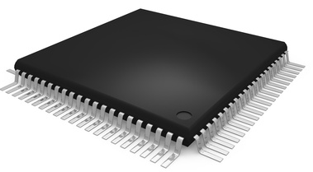
Reactively Caching Rules on Demand
Reactively Caching Rules on Demand
…
Controller
…
Rule Set
Install on demand
Preinstall
Switch

Slide 82
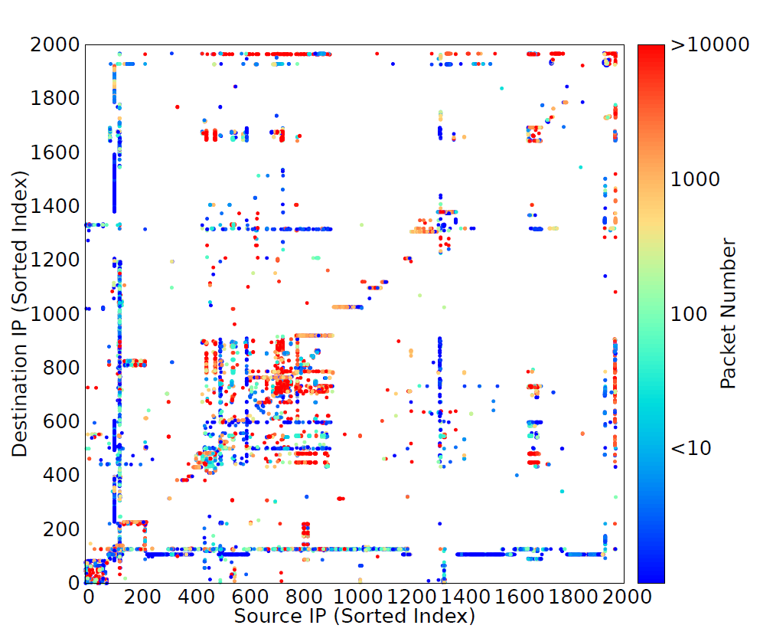
Caching Wildcard Rules
Caching Wildcard Rules
Wildcard Rules enables:
- Manage rules aggregately
- Less no. of rules stored. Less invocations to controller
- Easy Update
Locality of Traffic
Update!
NYC Dept.Edu (DoE) Data Center Traces

Slide 83
Challenge: Wildcard Rule Dependency
Challenge: Wildcard Rule Dependency
…
2
Dependency has chain reaction
f₃
1
F₂ (Dst IP)
f₁
f₂
3
F₁ (Src IP)
Rule set
Wrong
matching!
…
2
Caching
100s dependent
rules
f₃
1
f₁
f₂
f₁
f₂
f₃
3
Hypothetical
Switch Mem
90%

Slide 84
Methods to Accommodate Rule Dependency
Methods to Accommodate Rule Dependency
Cache all dependent rules
- Increase memory use for each flow
Cache exact match rules
- Leads to frequent rule installation (per-flow)
Split rule set and cache micro rules
- Generates significantly more rules
…
f₂
f₃
F₂ (Dst IP)
f₁
f₁
F₁ (Src IP)
Switch Mem
Inefficient rule management increases switch memory use causes
- more cache miss at switch
- higher controller load, control bandwidth
- longer flow setup delay
Problem: how to accommodate rule dependency with efficient mem use?

Slide 85
Solution: CAching rules in Buckets (CAB)
Solution: CAching rules in Buckets (CAB)
F₁
1
F₂
1
2
2
6
f₃
6
3
3
A
C
A
B
C
Associate
Rules
B
Cache Miss
Buckets
4
7
4
7
f₃
f₂
f₂
8
Bucket C
Rule 2
8
F
D
E
F
D
5
E
f₁
5
f₁
Bucket F
Rule 3
Rule 4
9
9
G
H
I
G
H
I
Rule set (Controller)
Switch Mem
Cache Miss at Bucket Filter
Matched Bucket F, and Rule 3
Install bucket A and rule 2 (&3)
f₂ is set up
Install bucket F and rule 3 & 4
f₃ is set up
f₁ is set up
Now no more 100s dependent rules
Only rules within requested bucket
Notes:
6:00

Slide 86
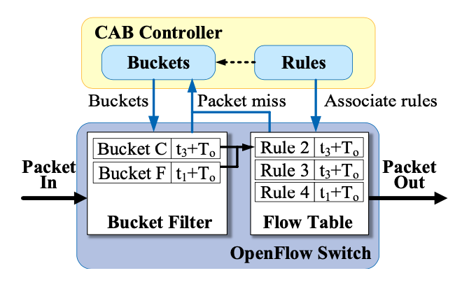
Bucket/Rule Deletion
Multiple buckets can share the same rules.
When deleting a rule, we must ensure that all the buckets that are associated with the rule have been deleted.
To guarantee this consistency we assign the same timeout value to the bucket and all its associated rules.
If a rule is found to have been cached earlier along with another bucket, the timeout value is refreshed according to the most recent installation.
At t₁, a flow f₁ arrives at the switch, resulting in installing Bucket F in the bucket filter and its associated Rules 3 and 4 in the flow table with timeout set as t₁ + T_{o}.
At t₂, a flow f₂ arrives and is forwarded to the flow table and matches with Rule 3.
At t3, a flow f3 arrives at the switch. It triggers the installation of Bucket C and Rule 2 with the timeout set as t₃ + T_{o}.
Rule 3’s timeout is changed to t₃ + T_{o} , so that it can be deleted together with Bucket C.

Slide 87
Bucket Generation Decision Tree
Bucket Generation Decision Tree
Decision tree based generation algorithm [HyperCut]
Partition till the no. of associate rules in each bucket is bounded
Bucket size
1
F₁
F₂
1
2
3
A
2
4
B
C
Technical problems:
How to select the fields to partition?

Slide 88
Bucket size affects memory efficiency
Bucket size affects memory efficiency
F₁
1
F₂
1
2
2
6
f₃
2x2 buckets
More rules cached each time
Unmatched rules cached
6
3
3
D
A
B
C
D
4
7
4
7
B
A
B
I
F
G
H
f₂
I
8
8
5
f₁
5
M
J
K
L
M
4x4 buckets
More buckets cached
9
9
D
C
D
O
P
Q
R
Choosing bucket size affects switch memory efficiency
Notes:
8:00

Slide 89
Bucket Size Trade-offs
Size of buckets affects the cache performance (cache miss rate)
A larger bucket can potentially reduce the flow setup requests, since more flows arriving at the switch tend to share the same bucket and aggregately generate fewer requests.
However, it can also lead to wasted space in the flow table (some rules are installed but not matched by any flows) and increase the chance of flow table overflow.
A larger bucket will also trigger installation of more rules each time it is requested, which consumes more control bandwidth.
A small bucket may reduce the unused rules cached in switches, but the switch tends to cache more buckets in the bucket filter, which also consumes space in TCAM.

Slide 90
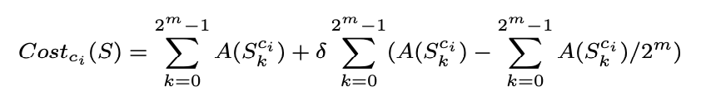
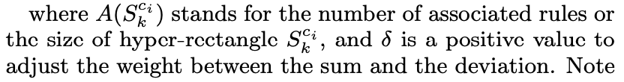
Bucket Generation Algorithm
Assuming there are d dimensions for the field space, each time we select m out of d dimensions to parturition a node. Suppose a partition candidate -
To determine the c_{i} to partition on S, we consider both the sum and the deviation of the sizes of nodes generated by a trial cut on c_{i}. We choose the c_{i} that minimize a cost function defined as follows,
By minimizing the sum of the node, we can reduce the redundancy of having the same rules associate with different buckets. By balancing the size of the nodes generated, we can avoid having some nodes with a relatively large size, resulting in the increase of the depth of the tree.

Slide 91
Preliminary Evaluation Setup
Evaluation Setup
Generate 4K synthetic rules using [Classbench]
Map the headers of NYC DoE traces for about 20 min to the synthetic rules
Test different caching schemes
Real traces from DC
Caching Schemes
Header mapping
Synthetic rules by ClassBench
Trace generator
Synthetic traces
Rule Caching Simulator
Notes:
Having:
Synthetic Rules from ClassBench
Real traces from NYCDoE Data Center
But they are not consistent. Many packets has headers matched to default rules in synthetic rules.
Map the headers of real traces onto the synthetic rules
Test the schemes use the rules and traces

Slide 92
Preliminary Evaluation Setup
Evaluation Setup
Performance Evaluation
Cache miss rate
Bandwidth consumption
Flow setup latency
Parameter Setting
TCAM capacity is set to support 1500 entries
RTT between the switch and the SDN Controller = 2ms
Effects of tuning bucket size (number of rules in each bucket
Comparison
CAching rules in Buckets (CAB)
Caching exact match rules (CEM) – Ethan and DevoFlow
Caching micro rules (CMR) - DIFANE
Caching dependent rules (CDR)

Slide 93
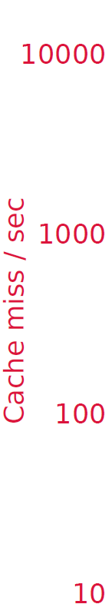
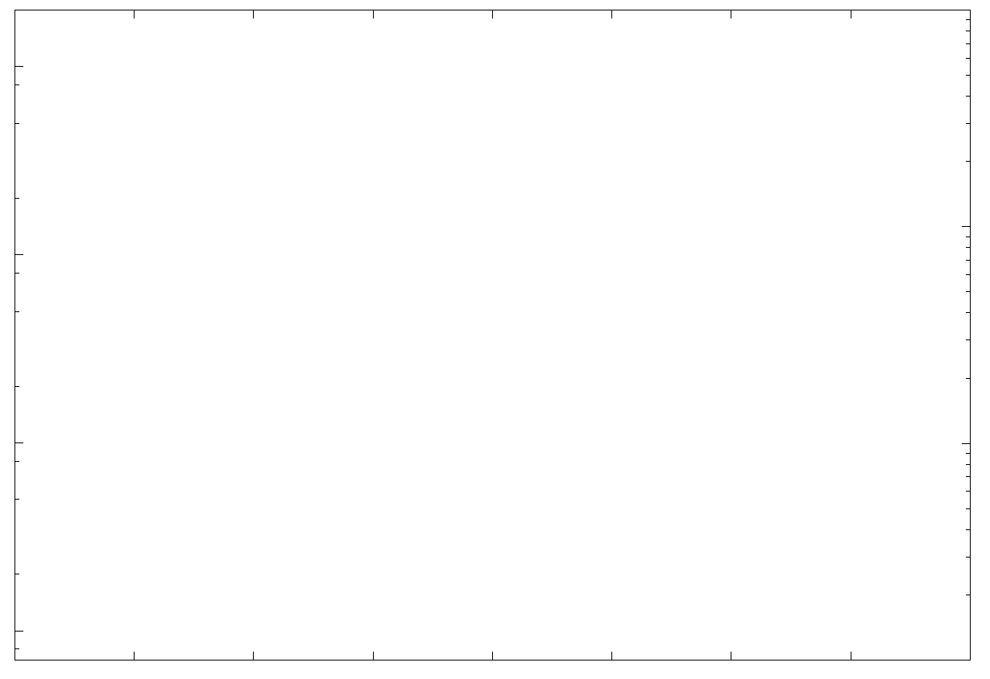
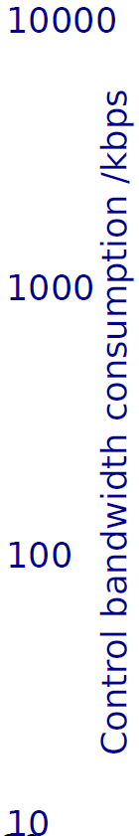
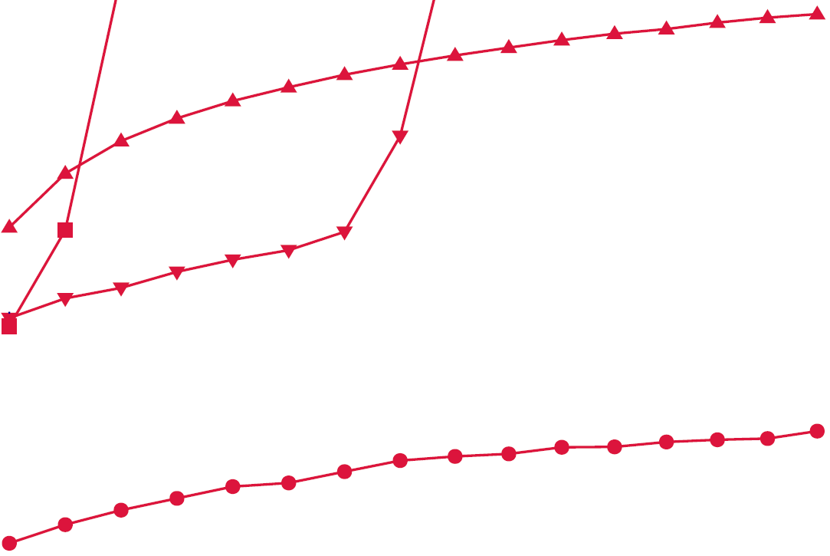
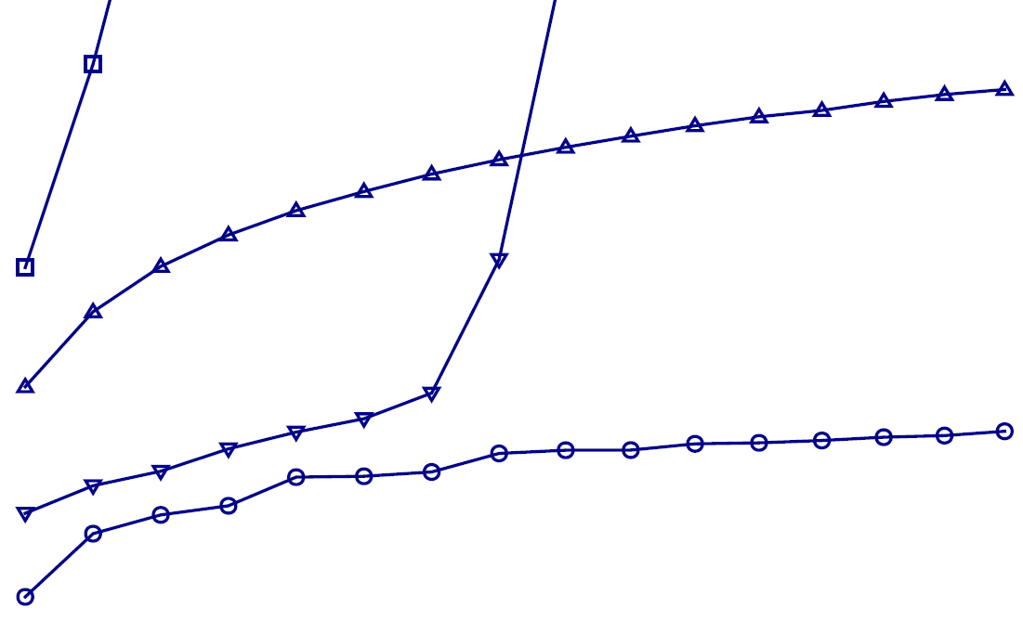

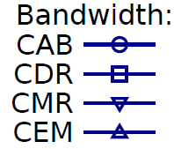
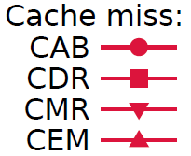
Cache miss and Control bandwidth usage
Memory overflow
CDR: Dependent Rules
CEM: Exact Match
CMR: Micro Rules
> half less control bandwidth use
> 10x less cache miss
CAB: Bucket + Rules

Slide 94
Preliminary Evaluation Setup
Performance Comparison
Caching exact match rules (CEM)
Since rarely do flows share exactly the same 5-tuple address, each flow arrival contributes to a cache miss in CEM.
Flow setup time = 1956.3 us @1000 flows/sec
Caching dependent rules (CDR)
Since it requires all the dependent rules to be installed, it quickly overflows the memory.
Flow setup time = 553.4 us @1000 flows/sec
Caching micro rules (CMR)
It benefits from caching micro range rules and performs better than the prior two. However, as too many micro rules are generated and cached, it also overwhelms the memory.
Flow setup time = 66 us @1000 flows/sec
Caching rules in Buckets (CDR)
It generates more than one tenth cache misses of CMR, and the bandwidth consumption is more than a half less.
Flow setup time = 37.9 us @1000 flows/sec

Slide 95
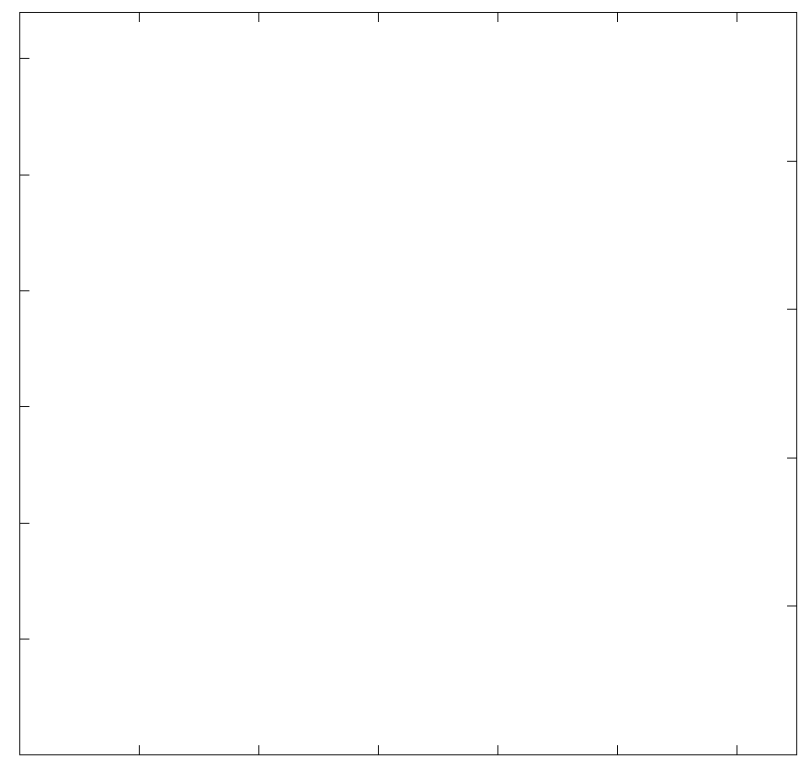
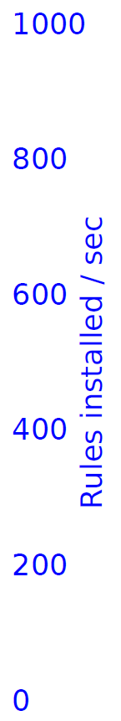
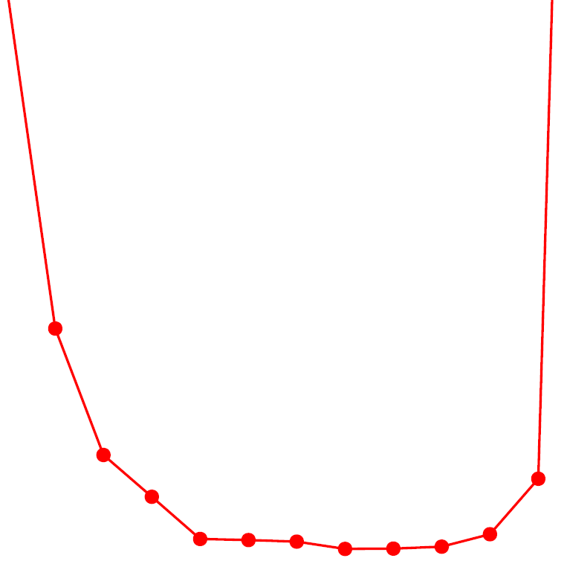
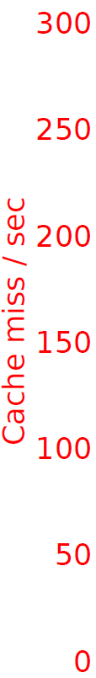
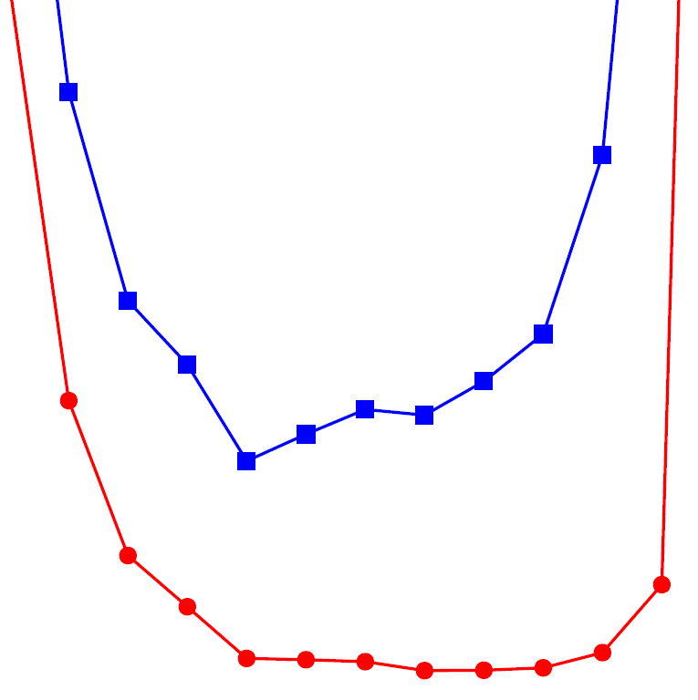


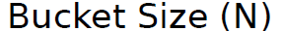
Effect of tuning bucket size
Memory overflow
Small bucket
Large bucket

Slide 96
Summary
CAB is a novel wildcard rule caching system which
Resolves rule dependency in wildcard rule caching
Achieves efficient switch memory use and helps reducing
control network bandwidth
flow setup latency
controller load
Fully compatible with the latest OpenFlow standards
Notes:
In summary

